Slide 1



Coffee Sales
By Himanshu Gautam
Linkedin
Github

Slide 2


The main objective of this project is to analyze retail sales data to gain actionable insights that will enhance the performance of coffee sales

Slide 3

Raw Data:
● Click here to access the dataset.
● This dataset contains detailed records of coffee sales from a vending machine.
● The vending machine is the work of a dataset author who is committed to
providing an open dataset to the community.
● It is intended to analyze purchasing patterns, sales trends, and customer
preferences related to coffee products.
Data Collection Period:
● The dataset spans from March 2024 to the Present time, capturing
daily transaction data. And new information continues to be added.

Slide 4
Data Manipulation and ETL:
● Converted text format to datetime format and currency format.
● Cleaning data to remove duplicates, missing values, and outliers
for accurate analysis.
Tasks:
● Time Series Exploratory Data Analysis
● Next day/week/month sales
● Specific customer purchases
Technologies used:
● MS Excel

Slide 5
Quantity Ordered Based On Hours
Row Labels | Count of Quantity Ordered
7 | 13.00
8 | 44.00
9 | 50.00
10 | 133.00
11 | 103.00
12 | 87.00
13 | 78.00
14 | 76.00
15 | 65.00
16 | 77.00
17 | 77.00
18 | 75.00
19 | 96.00
20 | 54.00
21 | 70.00
22 | 35.00
Grand Total | 1133.00

Slide 6
Total Revenue By Days
Row Labels | Sum of Total Bill
Monday | $ 4,969.68
Tuesday | $ 6,092.48
Wednesday | $ 5,327.20
Thursday | $ 5,466.74
Friday | $ 5,386.32
Saturday | $ 5,216.26
Sunday | $ 5,050.20
Grand Total | $ 37,508.88
Percentage Distribution based on
Card Vs Cash
Row Labels | Percentage of money
card | 91.51%
cash | 8.49%

Slide 7
Total Revenue By Months
Row Labels | Sum of Total Bill
March | $ 7,050.20
April | $ 6,720.56
May | $ 9,063.42
June | $ 7,758.76
July | $ 6,915.94
Grand Total | $ 37,508.88

Slide 8
Transaction By Product Category
Row Labels | Sum of Total Bill
Americano | $ 4,644.54
Americano with Milk | $ 8,601.94
Cappuccino | $ 7,333.14
Cocoa | $ 1,295.94
Cortado | $ 2,745.08
Espresso | $ 1,100.62
Hot Chocolate | $ 2,778.48
Latte | $ 9,009.14
Grand Total | $ 37,508.88

Slide 9
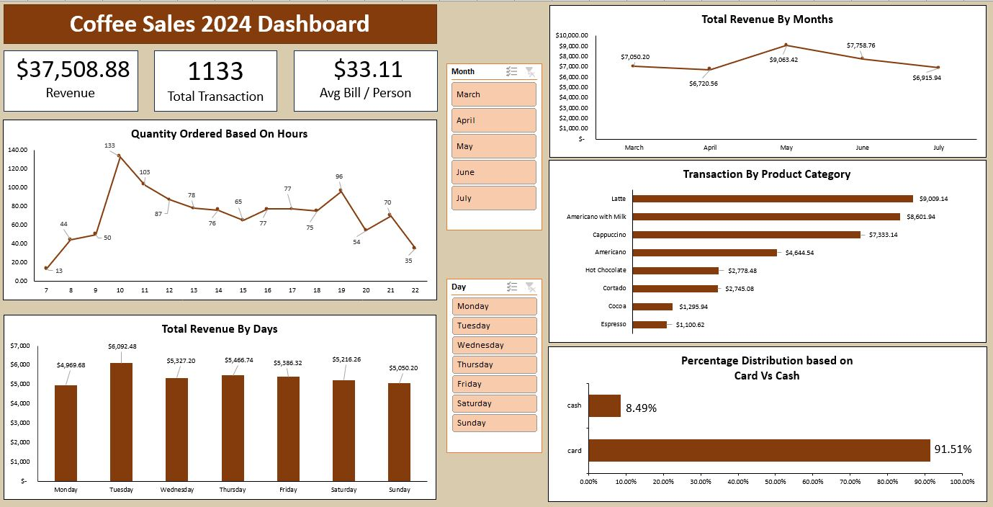

Slide 10
Sample Insights:
The peak period, when the largest sales are reported, is between 10 am and 12 pm.
The month of May records the biggest sales i.e., $9063.42.
The top five products are Latte, Americano with Milk, Cappuccino, Americano, and Hot chocolate.
Average Bill Per Person is $33.11

